Slide 1
Website Behavior Analysis
CAPSTONE PROJECT
Submitted by :Deepti Bhanot

Slide 2
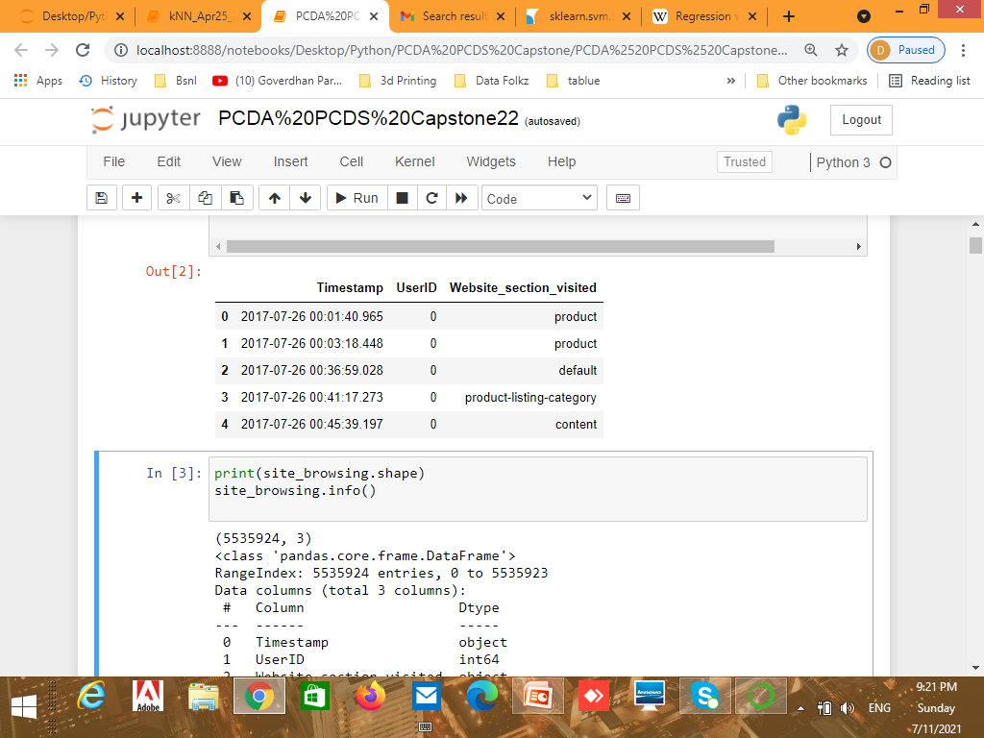
Problem Statement
The data shared by client contains
Log data of their User in : Problem2_Site_BrowingBehavior.csv

Slide 3
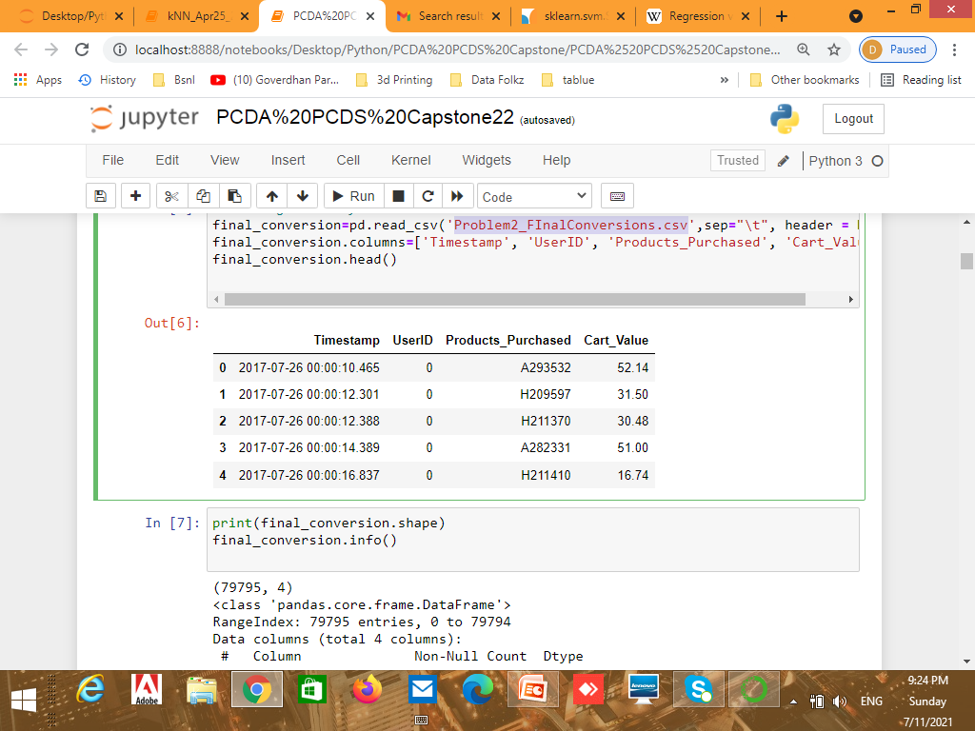
Final Conversion data in: Problem2_FInalConversions.csv

Slide 4
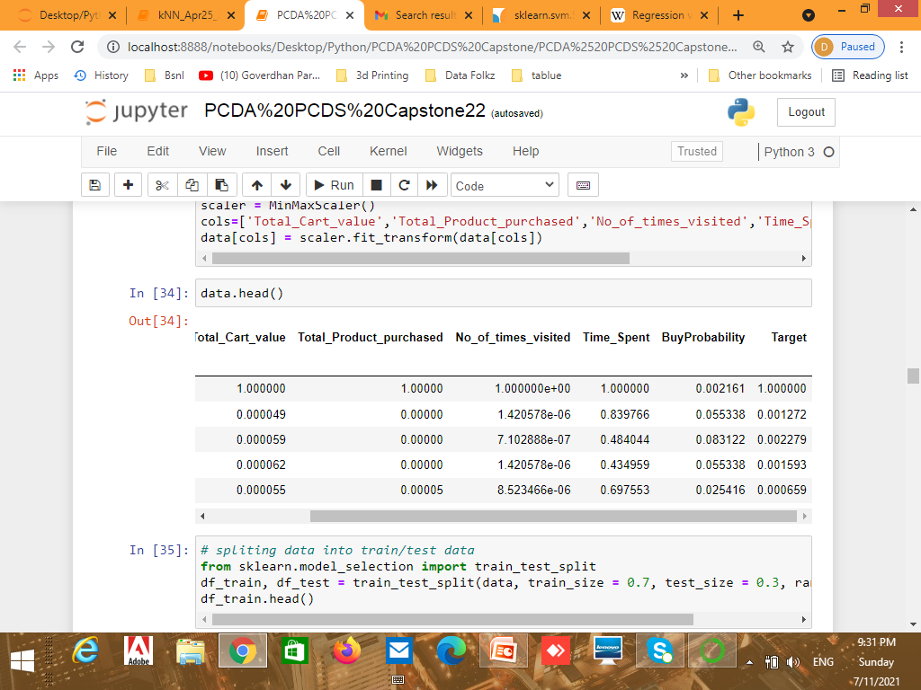
We need to perform feature Engineering on given data set to get final dataset

Slide 5
After performing Exploratory Data Analysis on final data set I come to know:
That feature No of times Visited Contains 155 blank values and % of null values in feature No of times Visited is 38%
The feature is imputed with value 1
Target feature is +ve correlated with Total cart value, Total product purchased and No of times visited.
The target feature is continuous in nature so the problem is of regression.

Slide 6
Model Selection
Models used for analysis are:
Linear Regression
Decision Tree Regressor
KNeighborsRegressor
SVR

Slide 7
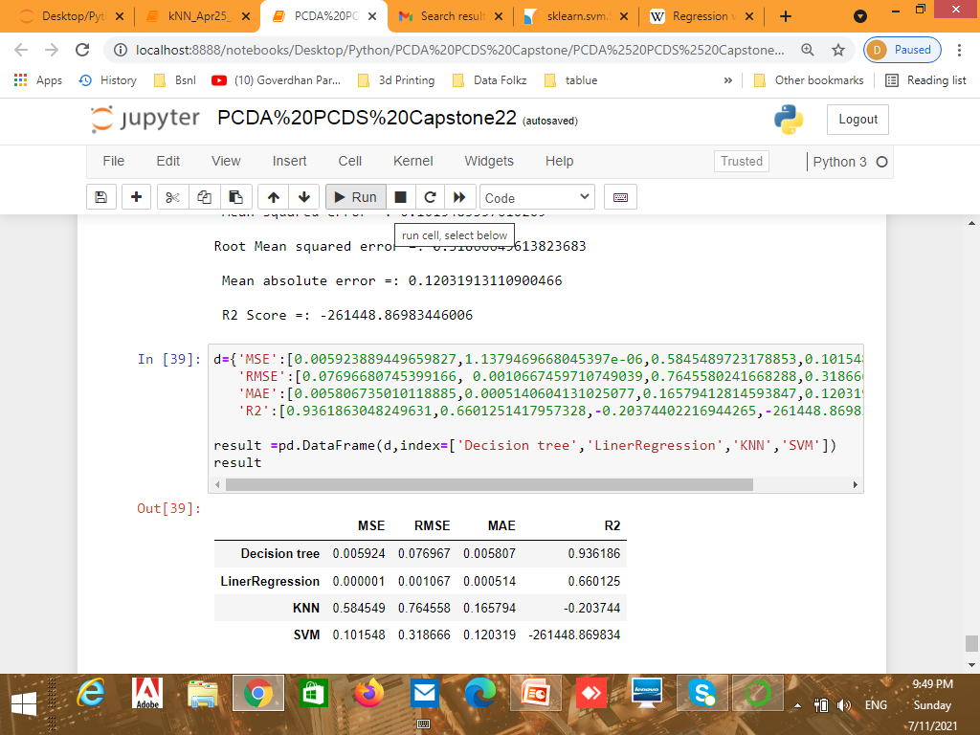
Performance of Models

Slide 8
The value of MSE,RMSE and MAE is minimum in Linear Regression so the Final Model is:
Target=-0.000811+Total_Cart_value11.290344+Total_Product_purchased*0.269231+ No_of_times_visited-10.558645+Time_Spent-0.000114+BuyProbability0.041629

Slide 9
The final audience for the above work is business team s who want to send offers to their website users so that they can be converted and buy products from site .

